Slide 1
Under Supervision of
Prof. Dr. Refaat Mahmoud Mohammed Farghaly
Professor of Meat Hygiene& Control
Faculty of Veterinary Medicine
Sohag University
Dr. Nahed Mahmoud Abdelaziz
Assistant professor of Meat Hygiene & Control
Faculty of Veterinary Medicine
Sohag University
Prof. Dr. Hassan Mohammad Gad el-rab
Professor Food Hygiene
Animal Health Research Institute,
Sohag Branch

Slide 2
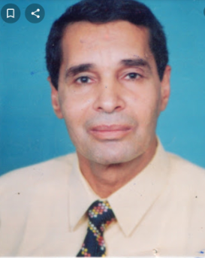

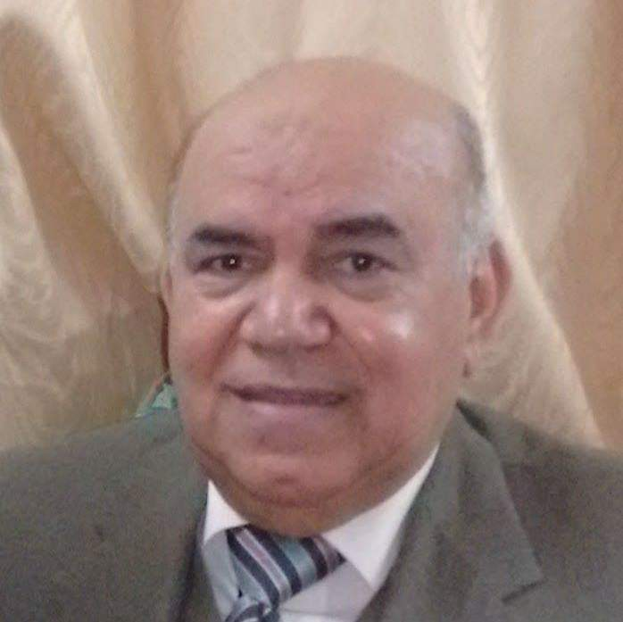
supervision

